Slide 1
An Introduction to Machine Learning
Vanessa Nilsen
Funded by Citrine Informatics

Slide 2
What is Machine Learning?
“… [E]very aspect of learning or any other feature of intelligence can in principle be so precisely described that a machine can be made to simulate it.” -John McCarthy (1956)
“Just as electricity transformed almost everything 100 years ago, today I actually have a hard time thinking of an industry that I don’t think AI will transform in the next several years.” -Andrew Ng (2017)

Slide 3
What is Machine Learning?
Formal Definitions:
Artificial Intelligence: Developing computer systems to perform tasks that usually require a human to complete.
Machine Learning: Developing computer systems that don’t require explicit programming to learn about the task they’re completing.

Slide 4
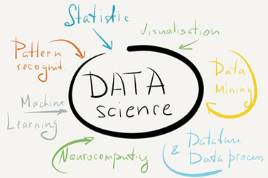
You May Have Heard Of:
Some other terms related to this field:
Data Science
Statistical Learning
Deep Learning

Slide 5
Models in ML
Models are what we create for machine learning.
DATA
Training
MODEL
PREDICTIONS
Values to predict
Characteristics of value being predicted
Key algorithm values
(Hyperparameters)

Slide 6
Data Structure
Features
Inputs
Descriptors
Formula | Color | Crystallinity | T_{melt} (ºC) | Band Gap (eV)
Si | Grey | Single Crystalline | 1414 | 1.2
GaAs | Grey | Single Crystalline | 1238 | 1.4
La₂S₃ | Red-Yellow | Polycrystalline | 2100 | 1.3
CaO | White | Amorphous | 2572 | 6.1
HgI₂ | Red | Polycrystalline | 259 | 2.1
Dependent Variable,
Output,
Class Label,
Target Variable

Slide 7
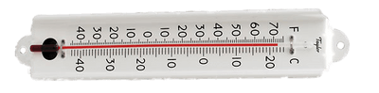
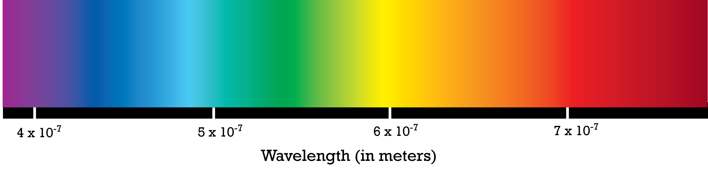
Data Types
Categorical: Data take discrete values
Continuous: Data take real values
Does the alloy contain metal?
How much metal is in the alloy?

Slide 8
Data Types and ML Tasks
Categorical
Continuous
Classification
Regression

Slide 9
ML Tasks
Classification: Predict a class label
Regression: Predict a class value

Slide 10
Broad Classes of ML Tasks
Values of Predictor are Known
Values of Predictor aren’t Known
Supervised
Unsupervised

Slide 11
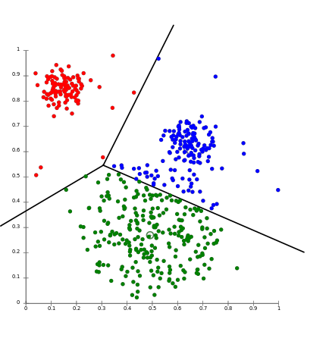
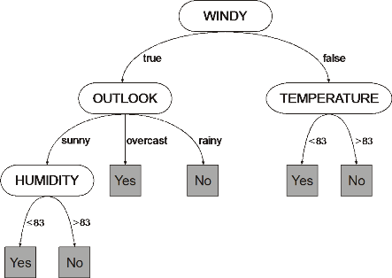
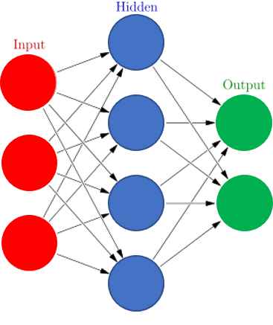
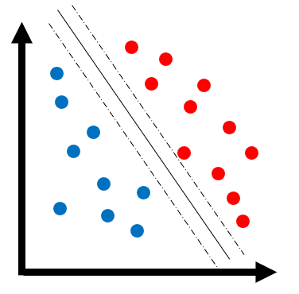
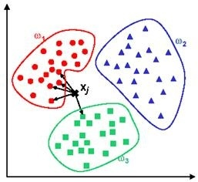
Machine Learning Algorithms
K-Means Clustering
K-Nearest Neighbors
Decision Trees
Random Forests
Support Vector Machines
Neural Networks
Bayesian Networks
Markov Models
https://commons.wikimedia.org/wiki/File:KMeans-Gaussian-data.svg
https://en.wikipedia.org/wiki/File:GEP_decision_tree_with_numeric_and_nominal_attributes.png
http://www.byclb.com/TR/Tutorials/neural_networks/ch11_1.htm
https://commons.wikimedia.org/wiki/File:Colored_neural_network.svg

Slide 12
Machine Learning Algorithms
K-Means Clustering
K-Nearest Neighbors
Decision Trees
Random Forests
Support Vector Machines
Neural Networks
Bayesian Networks
Markov Models
https://commons.wikimedia.org/wiki/File:KMeans-Gaussian-data.svg
https://en.wikipedia.org/wiki/File:GEP_decision_tree_with_numeric_and_nominal_attributes.png
http://www.byclb.com/TR/Tutorials/neural_networks/ch11_1.htm
https://commons.wikimedia.org/wiki/File:Colored_neural_network.svg

Slide 13
What’s a Decision Tree?
Anatomy:
Circles: Nodes
Uppermost node: Root
Arrows between nodes: Arcs
Nodes w/o arcs from them: Leaves
Details:
Each non-leaf node associated with a feature
Each leaf node contains a prediction
Each arc associated with a possible value of parent node
node
Root
Arc
df
Leaves

Slide 14
How Do Decision Trees Work?
Decision trees in ML analyze a dataset by splitting on features until only the class label or target label remains at a leaf node.
Feature listed at each node can be framed as a question and arcs are possible answers
Repeat the “ask a question and select an answer” process until a leaf node is reached.
The order questions are asked is based in information theory
Classification reduces impurity (entropy)
Regression reduces variance
Hungry?
Classification
Yes
No
…
…
Density?
Regression
<1
≥1
…
…

Slide 15
Decision Tree Hyperparameters
Root
node
Split Criterion
Arc
Maximum Tree Depth
Leaves
Min/Max Impurity at Leaf

Slide 16
Pros & Cons of Decision Trees
Pros:
Easy to visualize and understand
Train quickly
Simple to implement
Not confined to making a physical equation for new predictions
Cons:
Overfit easily
Can only split on 1 attribute at a time
node
Root
Arc
Leaves

Slide 17
K-fold Cross Validation
Split data into k subgroups
Train model with k-1 of the subgroups and test using the remaining subset
Repeat training and testing, using different subgroups as testing set, until all subgroups have been used for testing
Average results from each of the k round of cross validation
Typical values of k: 5 or 10
Round 1
1
2
3
4
5
Round 2
1
2
3
4
5
Round 3
1
2
3
4
5
Round 4
1
2
3
4
5
Round 5
1
2
3
4
5

Slide 18
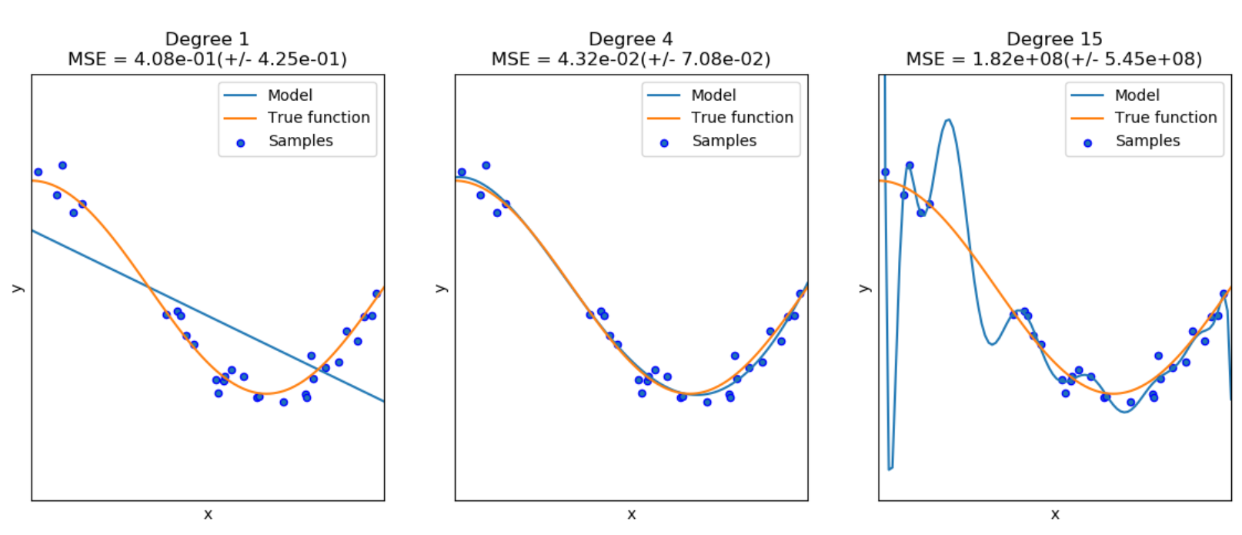
Overfitting
Overfitting occurs when a model has “memorized” the training data, not learned the pattern of the data
Underfit
Good Fit
Overfit
http://scikit-learn.org/stable/auto_examples/model_selection/plot_underfitting_overfitting.html

Slide 19
Cross Validation
How well will a model predict on new data?
Splitting data into “training” and “testing” subsets
A way to assess model’s performance on unknown data
Can tell if a model is overfitting
Can be computationally expensive

Slide 20
Random Forests
Ensemble of Decision Trees
Train multiple decision trees and have them vote on the final output of the model
Can utilize bagging (bootstrap aggregating) on data
Hyperparameters: All for decision trees + # of trees in forest

Slide 21
Random Forests
Pros:
Unlikely to overfit
In order for overfitting to happen:
A majority of classifiers would have to misclassify an instance
A majority of weights would have to be incorrect in regression
Cons:
Not easy to visualize

Slide 22




Neural Networks
ML algorithm used for complex tasks
Inspired by how brains function
Come in many “flavors”
Perceptrons
Convolution NN’s
Deep NN’s
Hyperparameters
Number of nodes
Degree of connectivity of nodes
Number of layers in network
https://en.wikipedia.org/wiki/AlphaGo
https://www.tensorflow.org/
http://logos.wikia.com/wiki/Siri
http://fortune.com/2016/02/02/new-uber-logo/

Slide 23
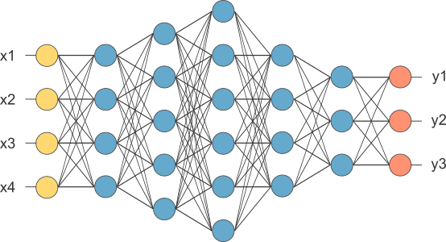
General Structure
Input
Layer
Internal Layers
Output Layer
DATA
PREDICTIONS
arcs
https://www.quora.com/What-is-the-intuition-behind-neural-networks

Slide 24
Internal Layers
Input: Outputs from units in previous layers combined with their weights
Unit contains an activation function
Linear Threshold Unit
Hyperbolic Tangent
Sigmoid (Logistic)
Rectified Linear Unit
Output is output of activation function
x₁
w₁
Activation
Function
w₂
x₂
w₃
x₃
threshold

Slide 25
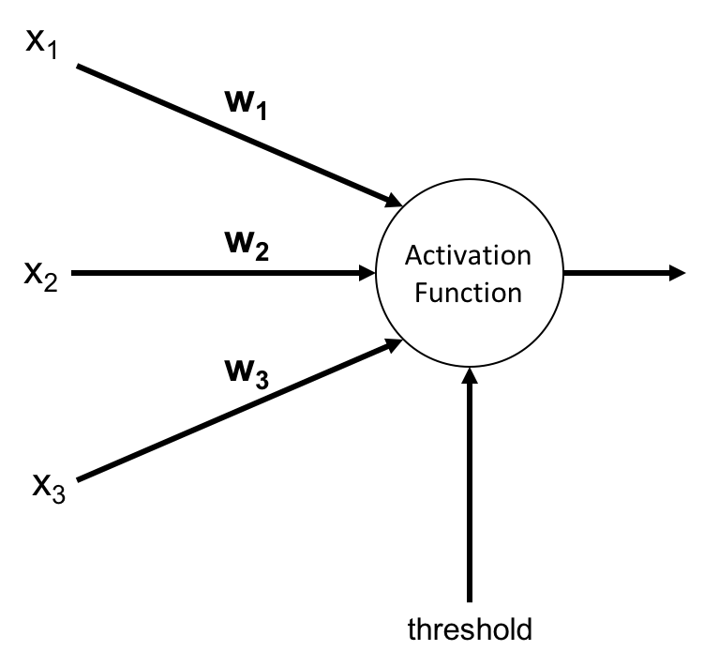
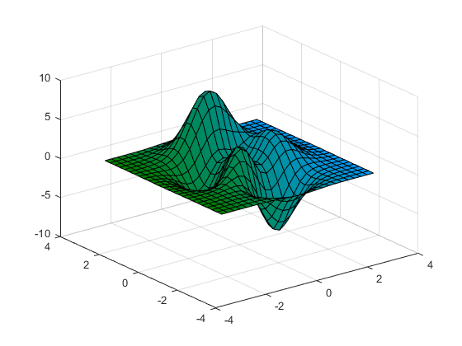
Internal Layers
Training involves sending data through the NN and updating the weights (w_{x}) to reduce error on the training set
“Back Propagation” can be used to update the weights
Error observed at output layer can be pushed back and distributed throughout hidden layers
Goal is to find global minimum of the error.
Minimum
https://www.mathworks.com/help/matlab/ref/surf.html

Slide 26
Output Layers
Gives predictions or value of regression
Each node at previous layer connected to every output node
Output nodes can contain simple activation functions to classify a sample or predict a regression value
For each data points, all nodes in output layer produce an output value

Slide 27
Neural Networks Recap
Pros:
Capable of performing complex tasks
Robust and tolerant to faults
Cons:
Take a long time to train
Many parameters to tune properly
Number of hidden layers
Number of nodes in hidden layers
Back-propagation requires labelled data
Deep NN’s require a lot of data

Slide 28
Assessing Classifier Performance
How many class labels are predicted correctly?
Methods for assessment:
Confusion Matrix
Precision
Recall
F1 Score

Slide 29
Confusion Matrix
Summarizes the prediction results of model
If classifying 30 compounds with:
10 metals
20 non-metals
Useful for calculating:
True positive rate
False positive rate
True negative rate
False negative rate
 |  | Actual Class
 |  | Metal | Non-Metal | Total
Predicted Class | Metal | 7 | 4 | 11
 | Non-Metal | 3 | 16 | 19
 | Total | 10 | 20 | 30

Slide 30
Confusion Matrix
If we’re trying to predict if an alloy is a metal…
 |  | Actual Class
 |  | Metal | Non-Metal
Predicted Class | Metal | # True Positive | # False Positive
 | Non-Metal | # False Negative | # True Negative

Slide 31


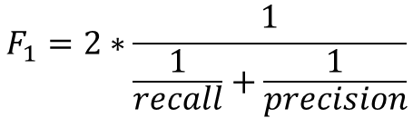
Precision, Recall, and the F1 Score
Precision: Positive Predictive Value
Recall: True Positive Rate
F1 Score: The harmonic mean of precision and recall
Values range from 0 to 1, with best performance at 1.
Notes:
Depending on the task, it may be more important to have a high precision than recall, or vice versa.

Slide 32
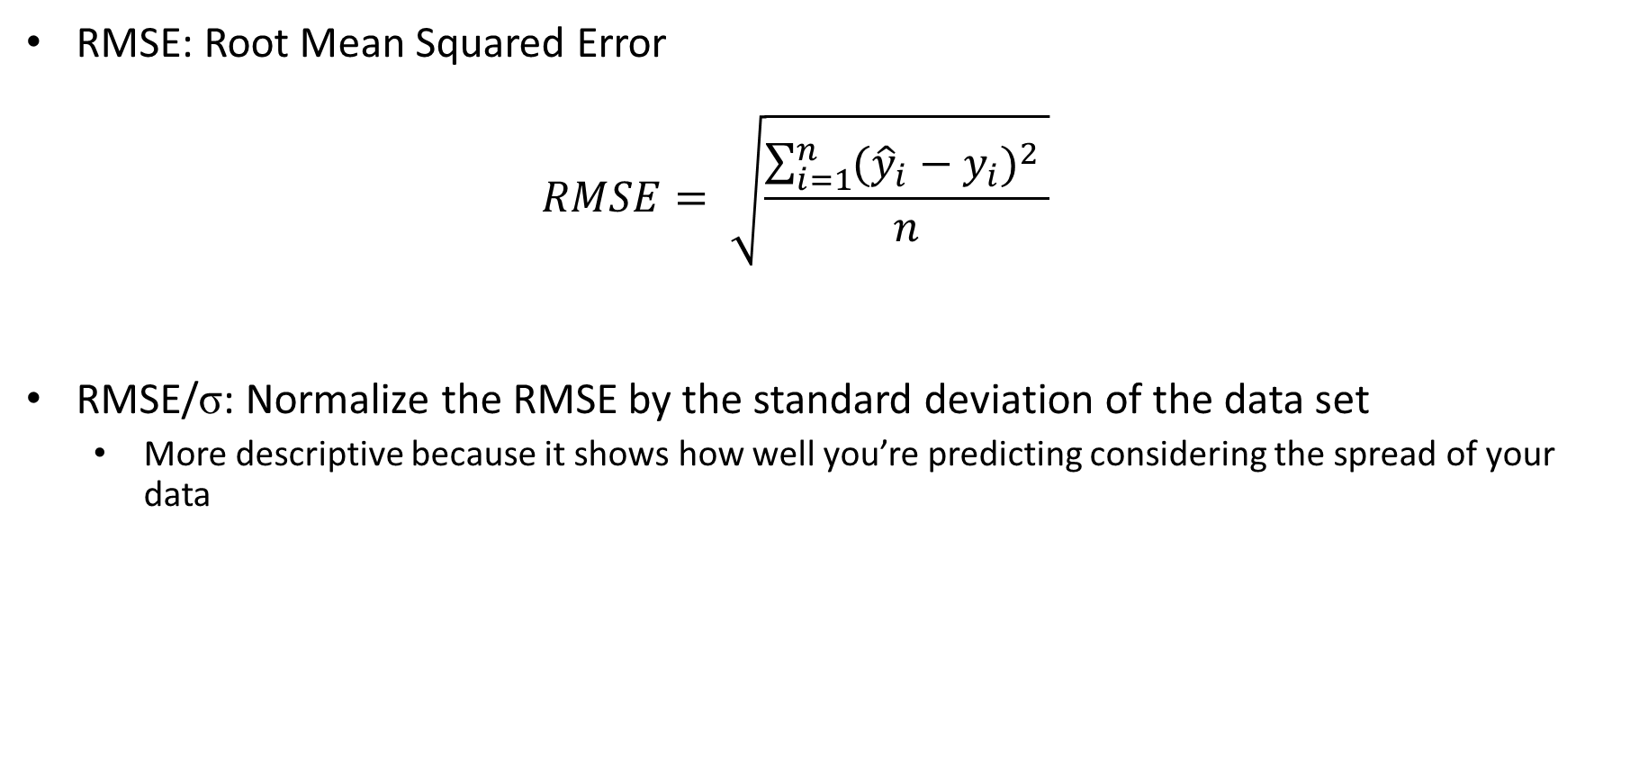
RMSE

Slide 33
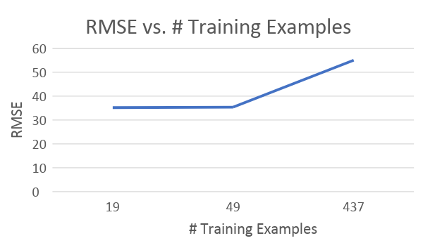
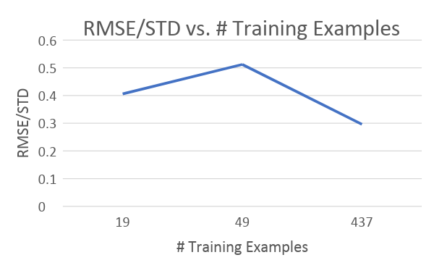
RMSE vs. RMSE/StD
# Training Examples | Mean of Data | RMSE | RMSE/STD
19 | 316 | 35.2 | 0.406
49 | 356 | 35.4 | 0.512
437 | 552 | 55.1 | 0.296

Slide 34
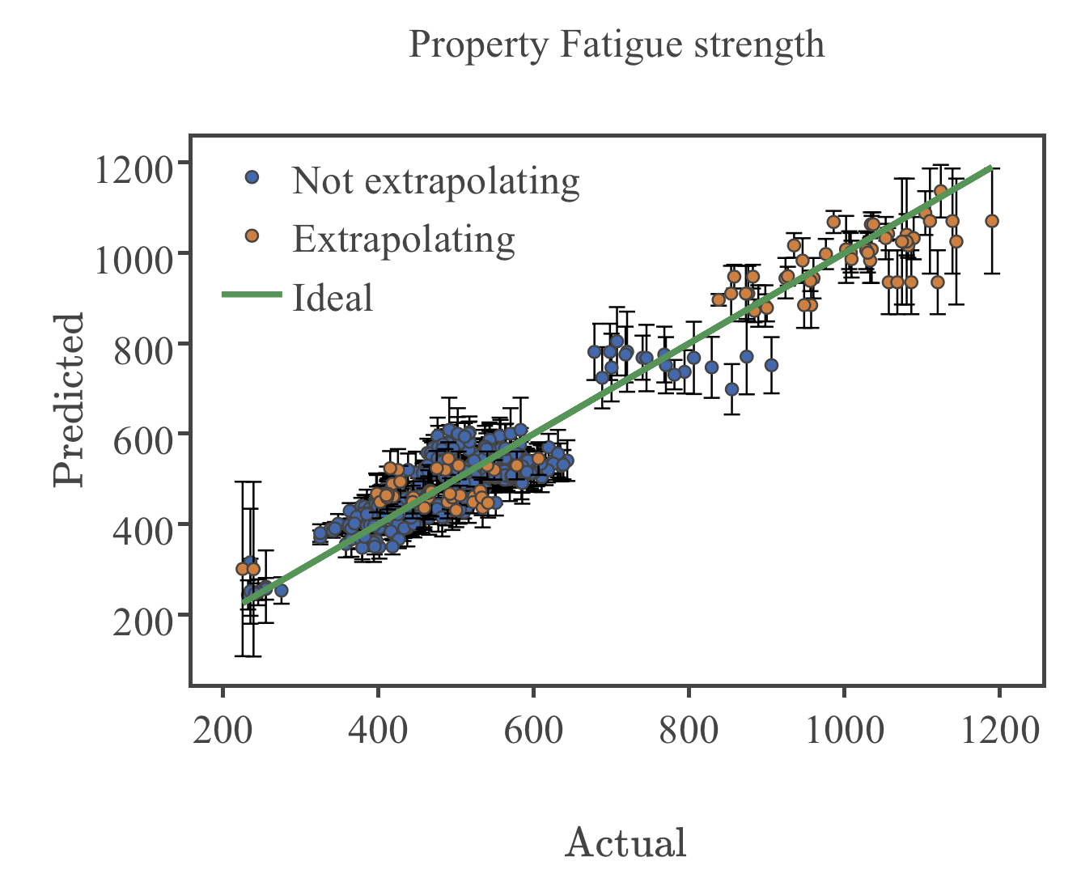
Parity Plots
Plots predicted values of model vs. actual values of class label
Quick way to visually assess regression performance
Each point on plot is an data point from data set
(x, y) coordinates of point correspond to actual value of class label for data point and predicted value of
Perfect prediction would be all data on y = x line (green)
Example Parity plot from Citrination

Slide 35
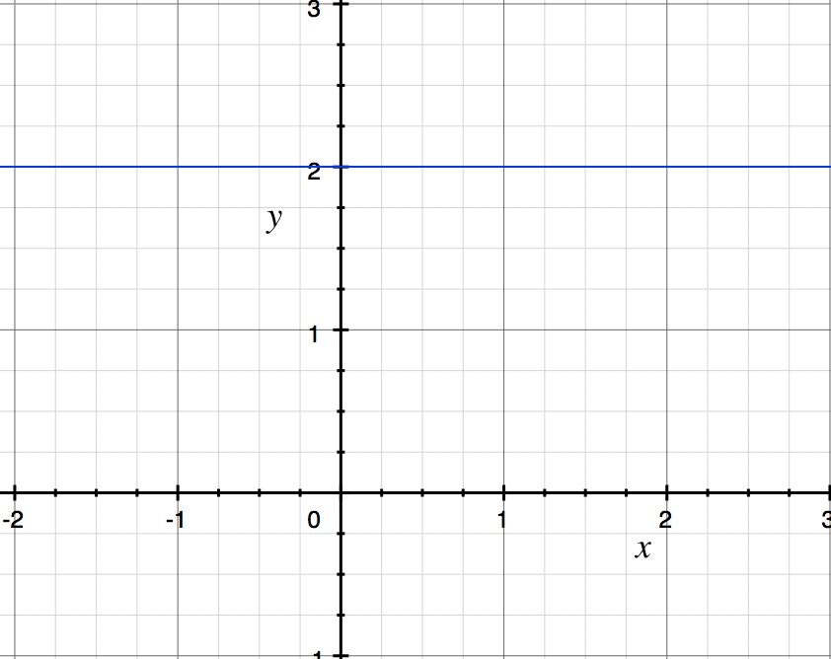
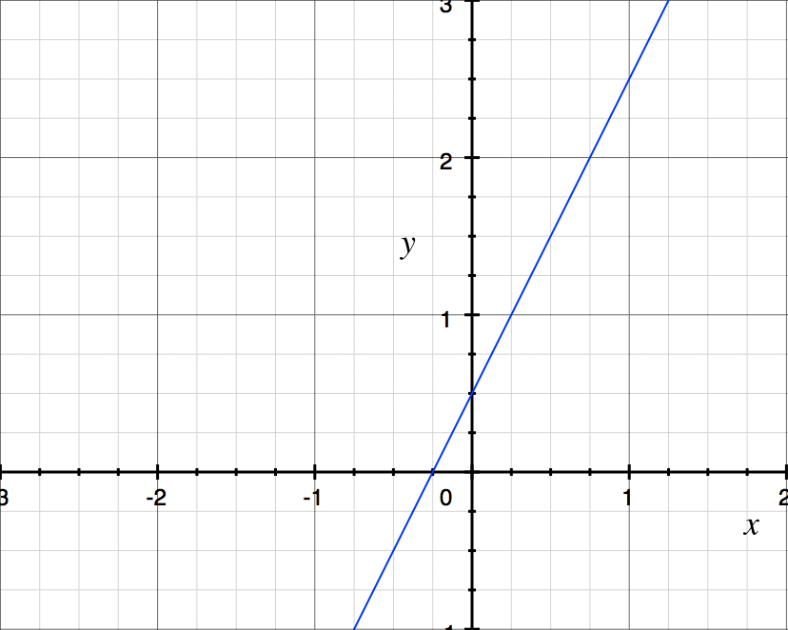
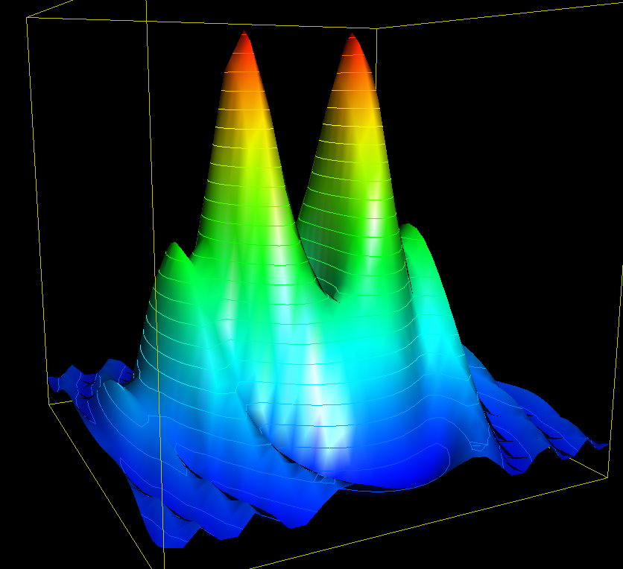
Visualizing High-Dimensional Data
Low-Dimensional Data
Data contains 3 or fewer dimensions
High-Dimensional Data
Data contains 4 or more dimensions
?

Slide 36
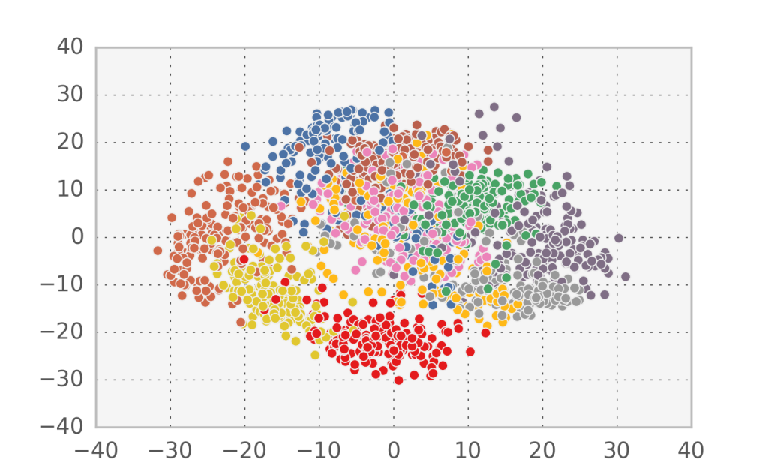
PCA
Principal Component Analysis
Linear method reduce dimensionality
Creates a linear projection of data such that variance of data set is maximized.
Clusters that are far apart are different, but close together are sometimes harder to interpret
If data isn’t linearly separable, PCA plot may not give much information
http://www.nehalemlabs.net/prototype/blog/2015/04/13/dimensionality-reduction-101-linear-algebra-hidden-variables-and-generative-models/

Slide 37
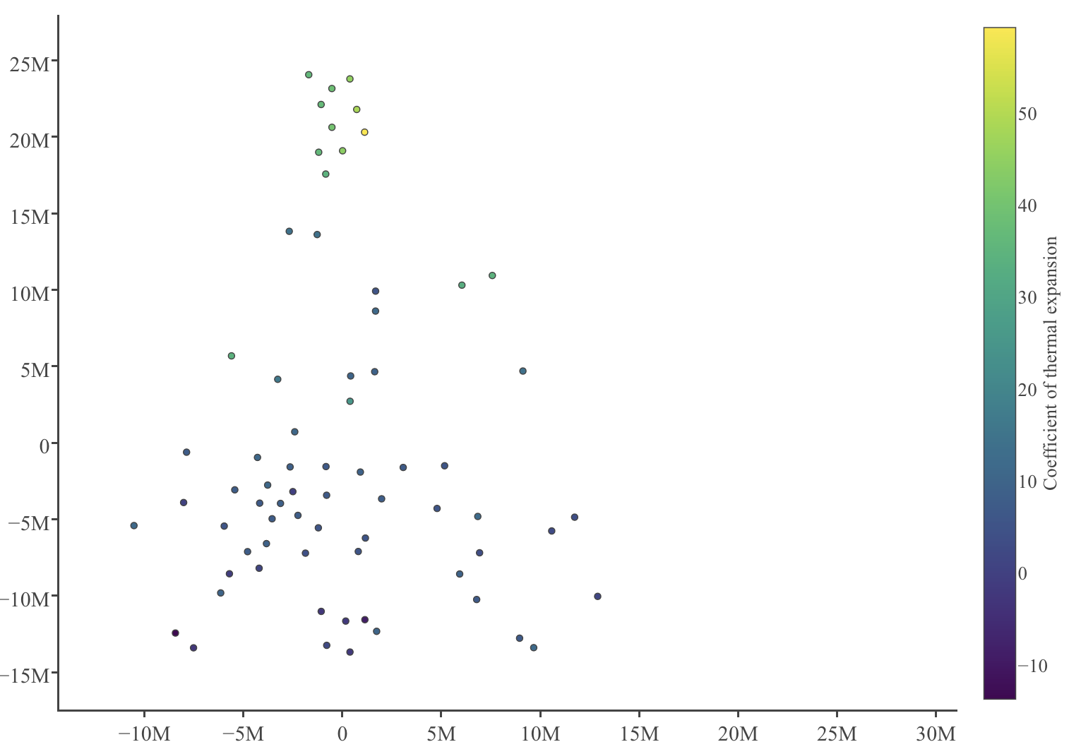
Data Visualization: t-SNE
t-Distributed Stochastic Neighbor Embedding
Can reduce high dimensional data to 2-3 dimensions through non-linear methods
Creates scatter plots by creating probability distributions to determine how likely 2 points are to be paired (near one another)
Near points are alike. Far points don’t tell much.
Can preserve local structure by tuning “perplexity” of distributions
t-SNE plot from Citrination.

Slide 38
Data Visualization: t-SNE
Clusters of similar data points

Slide 39
Data Visualization: t-SNE
A
Can’t determine if B or C is more different from A
C
B

Slide 40
Thank You

